Slide 1
Enhancement in Career Finder
Batch No.: 9
Presented by S.Pooarasu (810020104058) & V.Vigneshwaran (810020104083)
Under the Guidance of Dr.S.Sivanesh

Slide 2
Table of content
Objective of the System
Abstract of the System
Introduction of the System
Stakeholders of the System
Schedule (Gan chart) of the System.
Graphical Abstract
Data flow diagram
Contribution
Hardware & Software Specification
Implementation Phases
Performance
Future Work
Conclusion
Reference of the System

Slide 3
Objective
The job portal aims to provide job seekers with a user-friendly platform to search and apply for job openings based on their qualifications, experience, and preferences with additional features. The portal should be designed to provide relevant and accurate job search results and facilitate communication between job seekers and employers.

Slide 4
abstract of the system
The purpose of this project is to enhance a job portal website by adding additional features that will improve the user experience and increase the likelihood of successful job matches.
Integration with job application tracking systems to help job seekers keep track of their applications and progress.
Integrating resume builder and blogger. Resume which helps to present your qualification and secure an interview.
Blogger which helps to share job seeker’s interview experience and company reviews.

Slide 5
Introduction of the system
A job portal is an online platform where job seekers can search for job vacancies and employers can post job openings. It serves as a meeting point for job seekers and employers, making the job search and recruitment process easier and more convenient.
In addition to the basic features of a job portal, such as job search and job posting, there are several additional features that can make a job portal more useful and efficient. Some of these additional features are:
Resume builder
Applicant tracking system
Blogger

Slide 6
stakeholders of the system
Job seekers: These are the individuals who are looking for employment opportunities and use the job portal to search for and apply to relevant job openings.
Employers: These are the companies or organizations that are looking to hire new employees and post job openings on the job portal.

Slide 7
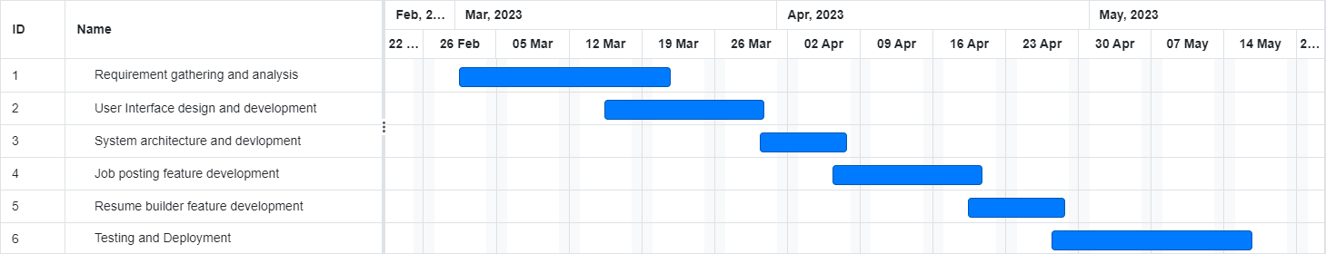
Schedule / ganTT chart

Slide 8
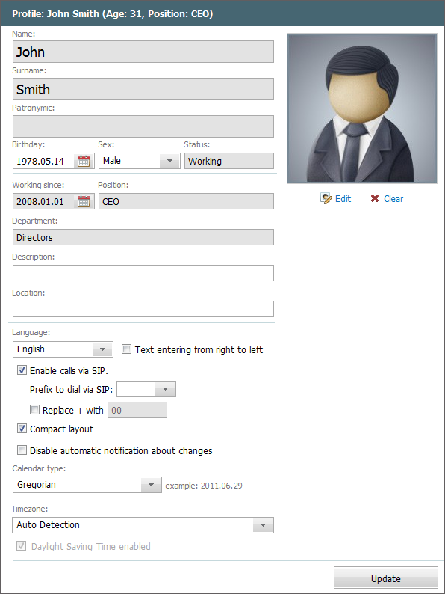

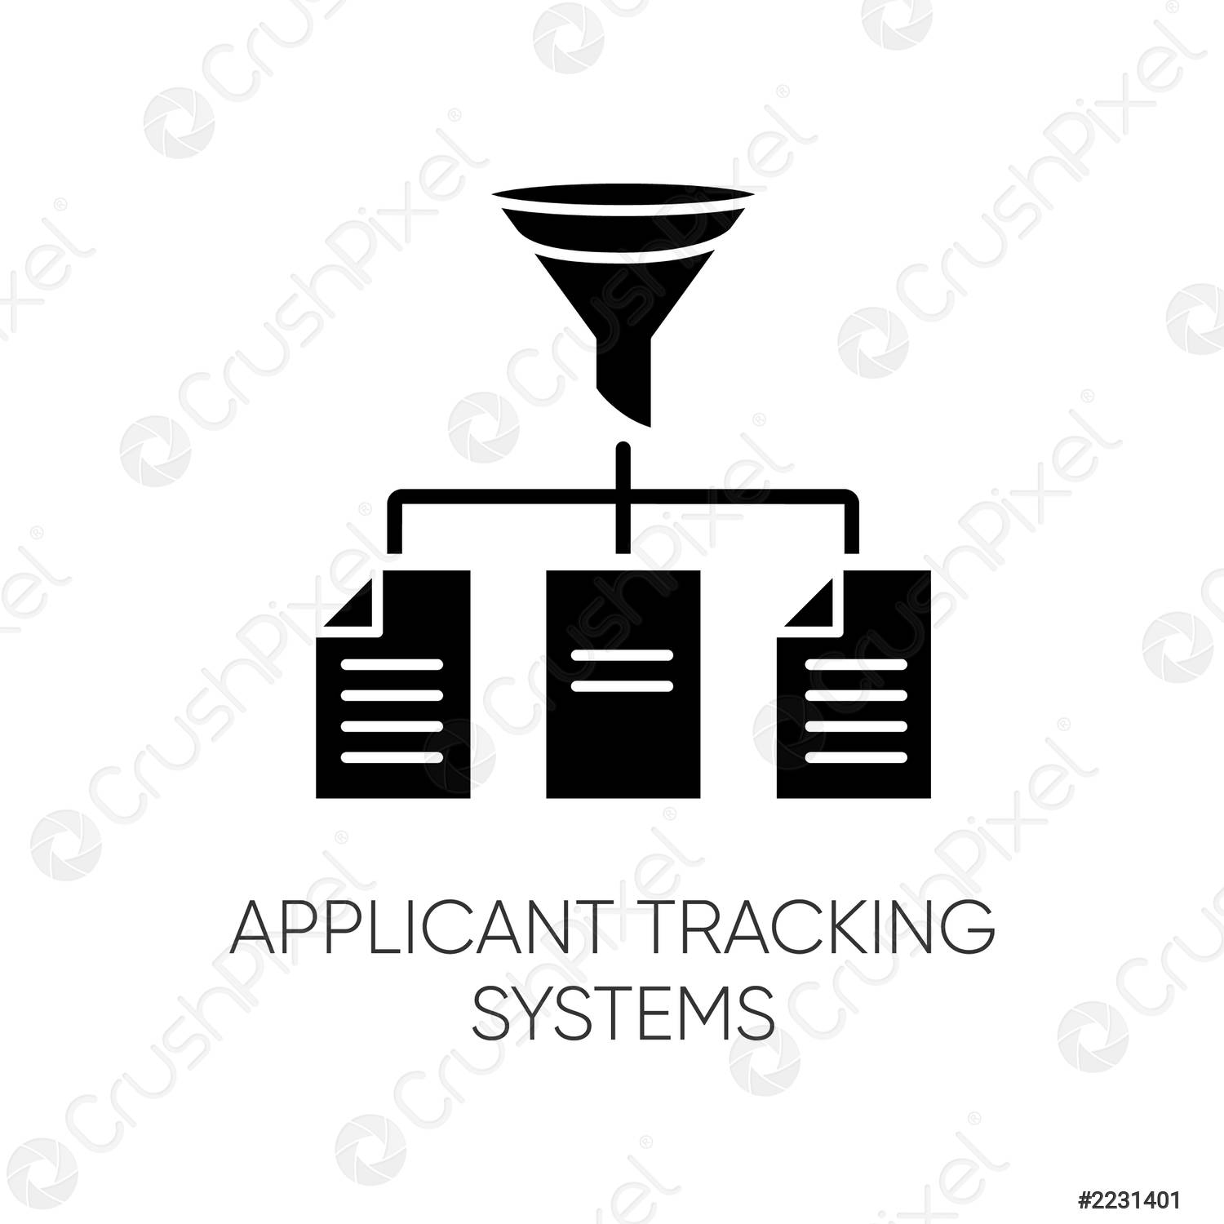







Graphical Abstract
Job seeker login
profile
Generate resume
Apply job & track your application
Employer login
Search/Write blogs
Send mail
Company profile
Company name
Job tittle
Post Job with description
Job Description

Slide 9
Data flow diagram: level 0
Search jobs
Job seeker
Job seeker login
Generate Resume
Jobs
Search / Write blogs
Employer
Employer
Login
Post jobs

Slide 10
Data flow diagram: level 1
Job seeker login
Authentication
Job seeker page
Generate Resume
Job seeker
Job seeker
Registration
Job seeker
Write blogs
Search blogs
Search jobs
Apply job
Job seeker details
blogs
Track application
Employer login
job details
Post jobs with description
Employer
Employer
Registration
Authentication
Job seeker page
Employer details

Slide 11
system architecture
Login
Employer Login
Job seeker Login
Employee
Write blogs
Post jobs with description
jobs
Search jobs
Generate resume
Search blogs
Apply job
Track application

Slide 12
contribution
Vigneshwaran V(810020104083) : Working with frontend using html, css. Implementation of web pages, web designing, blog creation.
Pooarasu S(810020104058) : Working with backend using Node JS and MongoDB. Implementation of backend, database connection , resume generator and documentation.

Slide 13
Hardware & software requirements
Hardware Requirements: RAM-4GB, ROM Space Required 1GB, Minimum Processor- i3 or Ryzen 3.
Software Requirements:
Operating System either windows or linux.
Frontend: Html, CSS, JavaScript, EJS
Backend: Node JS
Cloud Database: MongoDB

Slide 14
implementation phASES
The development and implementation of the project is categorized into Five phases:
Job seeker Login
Employer Login
Resume Generator
Blog Post
Database Connectivity

Slide 15
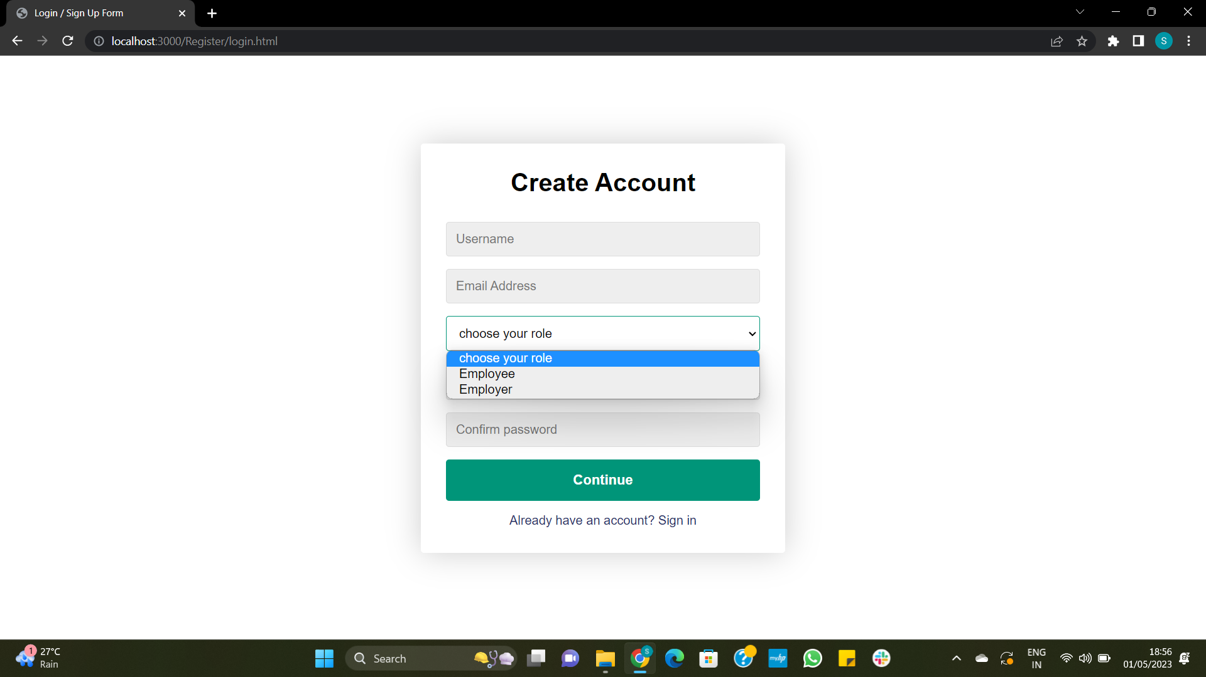
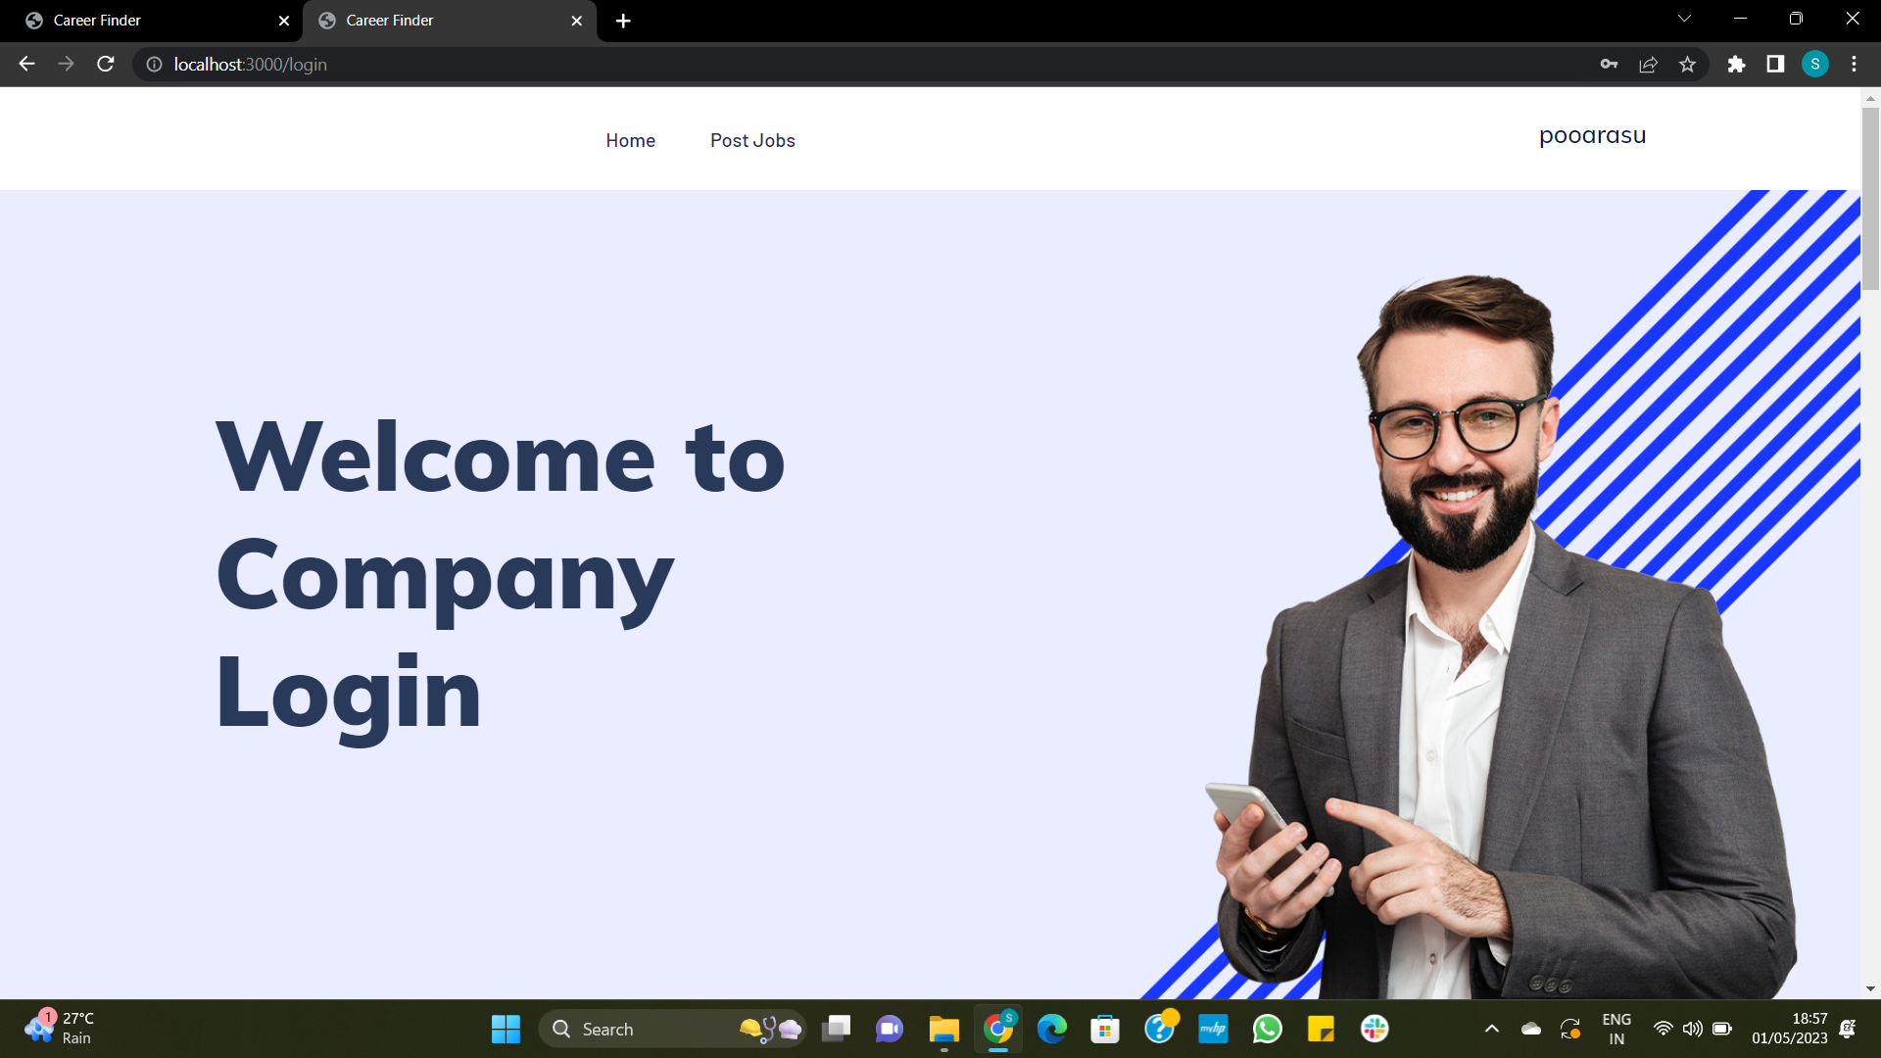
Login page

Slide 16
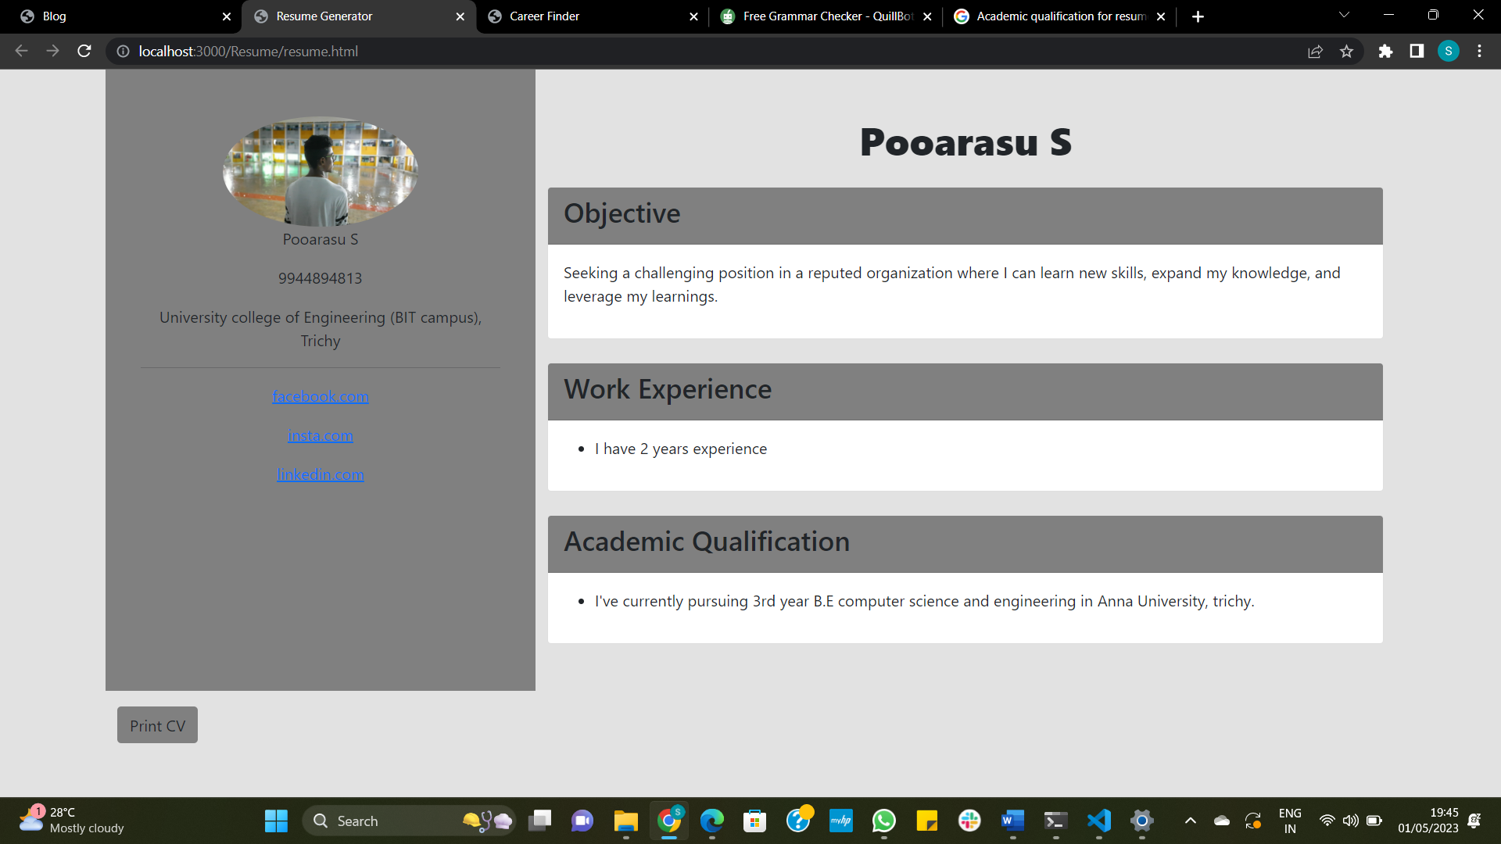
Resume builder

Slide 17
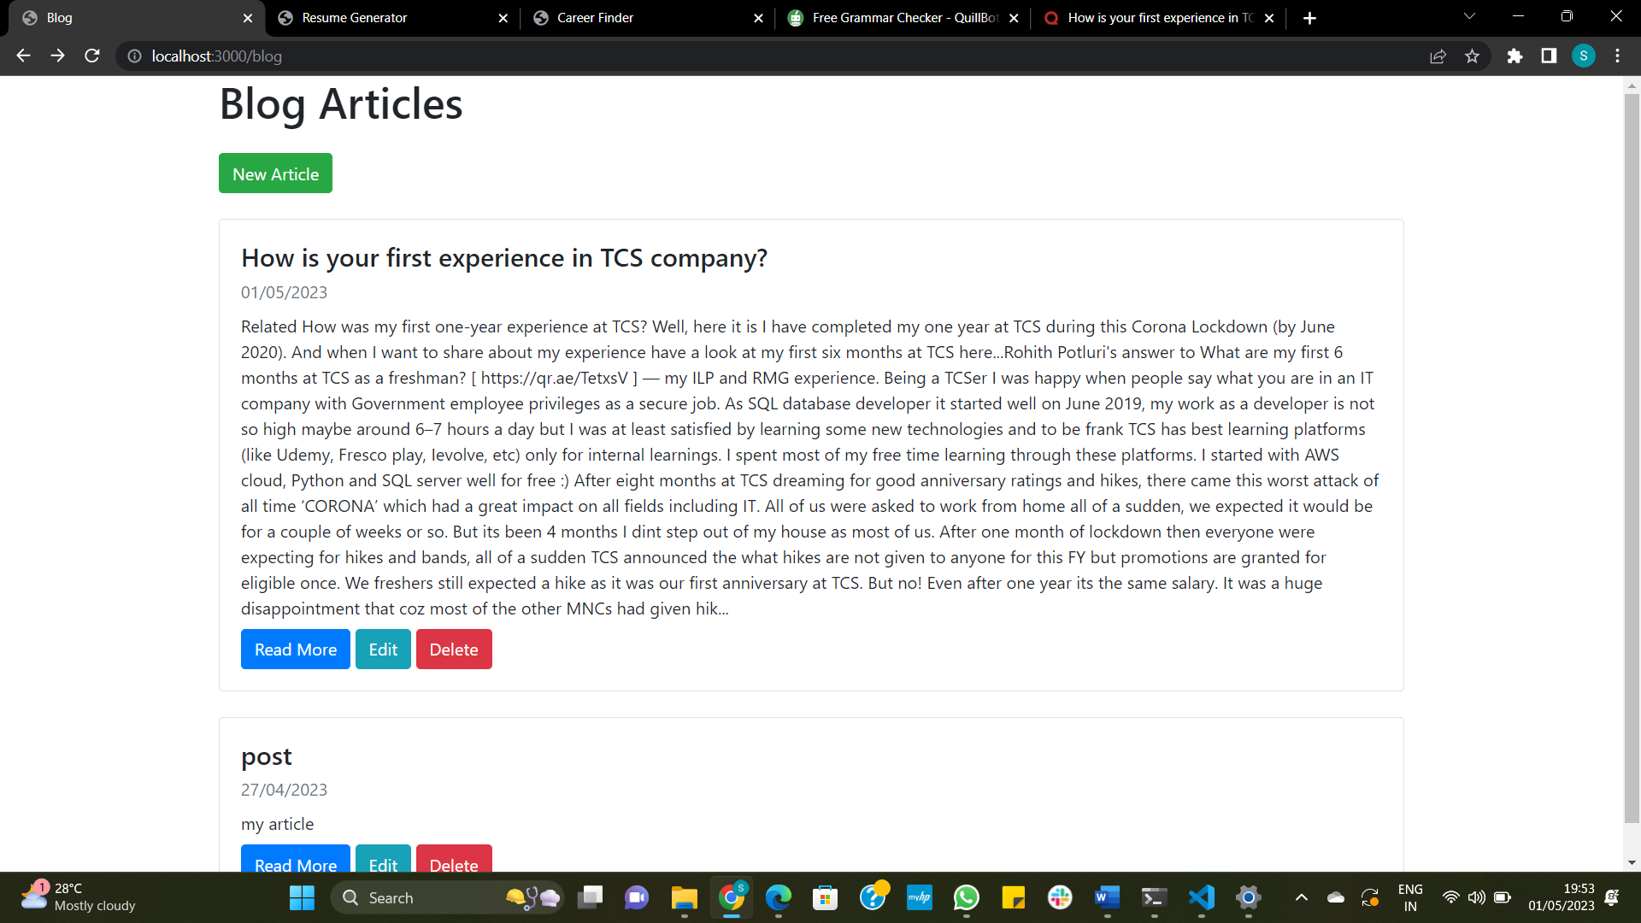
Blog

Slide 18
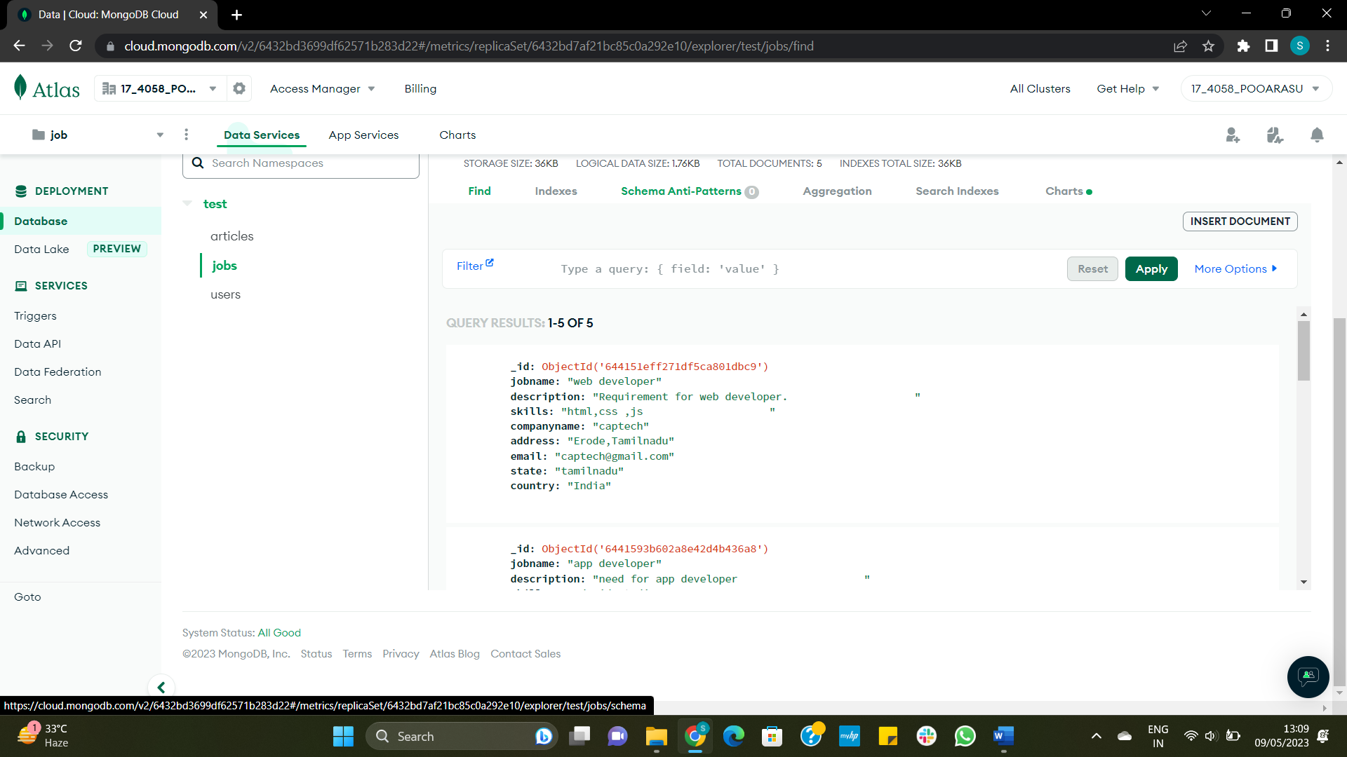
Database connection

Slide 19
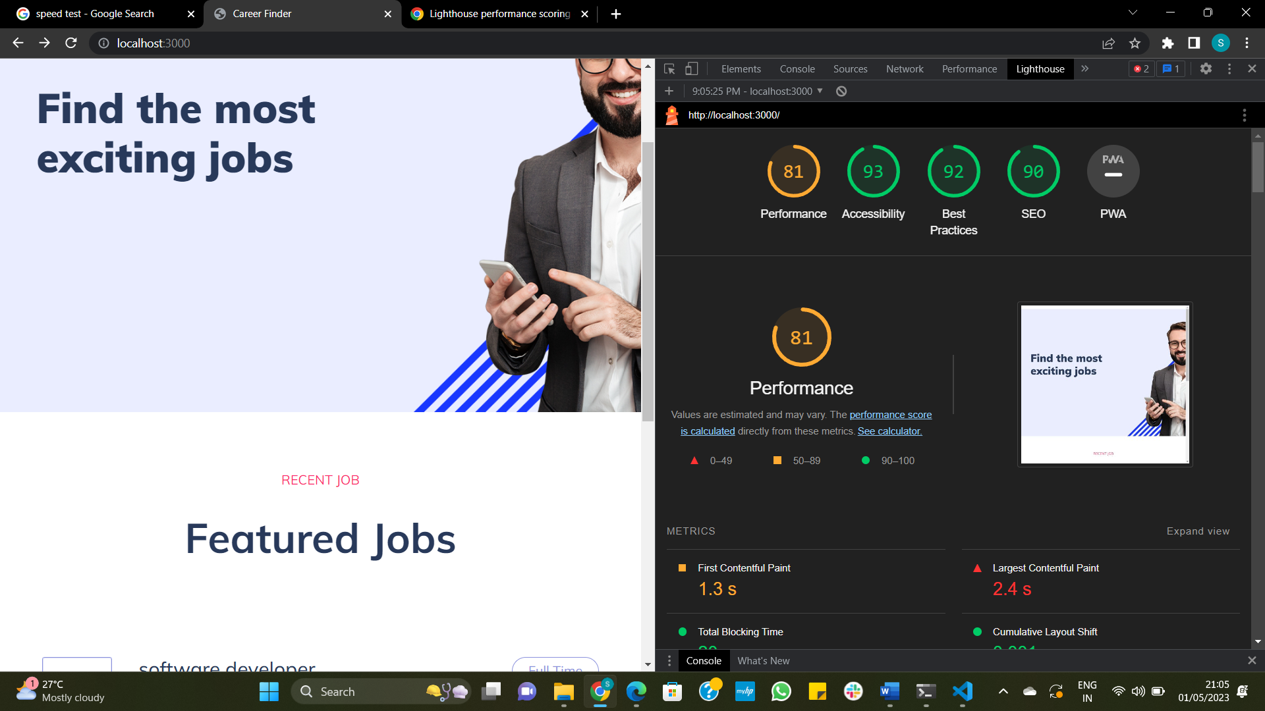
pERFORMANCE
Lighthouse is an open-source, automated tool that can help with performance analysis.

Slide 20
Future work
Job portals rely on employers and recruiters to post job openings and keep information up-to-date. However, not all employers or recruiters may use job portals or keep their information up-to-date, leading to inaccurate or outdated job postings.
The design part can be made more attractive in future. Further enhancements can be made in designing the screens.
Job seekers may need to use multiple job portals or other job search methods to find all of the available jobs. This problem can be solved in future.

Slide 21
CONCLUSION
This project describes the work on the title Enhancement in career Finder in an effective manner. Performance measure of this project work is obtained as 81% with the help of lighthouse software tool. The web page runs without any error and all the modules are well tested. It is an online platform designed to connect job seekers with various industries to provide the suitable employment opportunities.

Slide 22
Reference of the system
There are many references of job portals with additional features available online. The few examples are LinkedIn, Glassdoor, Indeed, Naukuri, Freelancer, Internshala.
Sourced from the Research Paper published by Sagar P, Muskan Singh, Veebhuti Arun Sai Teja, Vani Shinghal, Nitesh Kumar based on "A study of issues in job portals: research analysis”.
Sourced from the Research Paper published by Dr . Rupa Rathee and Miss. Renu Bhuntel based on " Factors affecting e-recruitment ”.
Sourced from Google Wikipedia .

Slide 23
THSNK
THANK YOU

